Slide 1



SUBMITTED BY :
SWASTICK DEY
TEJODEEP MITRA ROY
SWAGNIK SARKAR
SUSHANTA KARMAKAR
SUBHRA ROY
SOUBHAGYA NASKAR
In partial fulfilment for the award of the degree of
BACHELOR IN COMPUTER A
PPLICATION (BCA)
DEGREE IN
TECHNO MAIN SALT-LAKE
AMBULANCE MANAGEMENT SYSTEM

Slide 2



INTRODUCTION
Purpose
An ambulance management system is designed to efficiently dispatch and monitor emergency medical service (EMS) vehicles, particularly ambulances, in response to medical emergencies. It encompasses the management of the entire ambulance fleet, including resource allocation, vehicle tracking, and coordination of EMS. By facilitating quick and effective responses to medical emergencies, it enhances the chances of saving lives.
The system also optimizes resource utilization by ensuring ambulances are deployed to the most urgent and critical situations. Furthermore, it provides real-time data and analytics for informed decision-making and resource allocation during emergencies. Improved communication between EMS personnel and hospital staff is another benefit, enhancing the overall efficiency of the emergency medical services system.

Slide 3


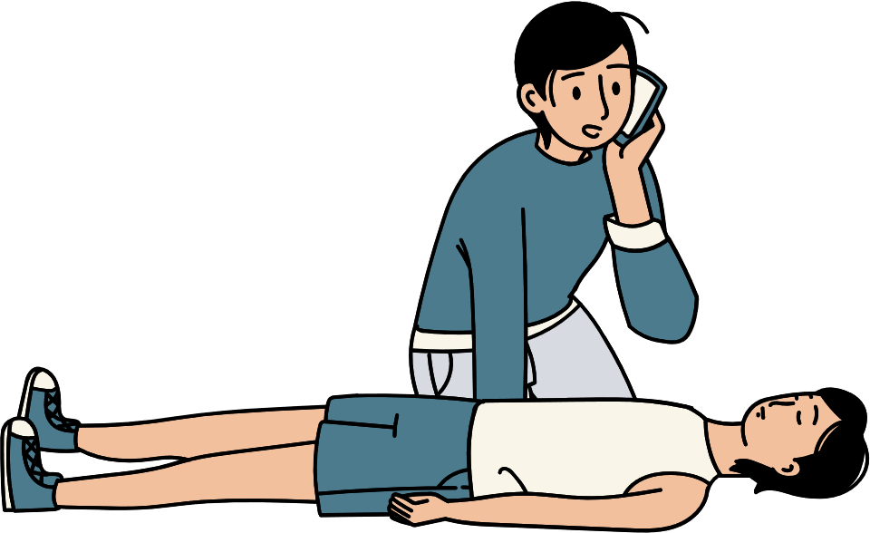
System scope
The scope of an ambulance management system encompasses various features and functions essential for the effective management and coordination of emergency medical services. These include ambulance dispatch, resource allocation, vehicle tracking, patient data management, communication, and reporting/analytics. The system should have a centralized dispatch function to receive emergency calls and dispatch the appropriate ambulance. It should allocate resources based on the severity and urgency of the medical emergency.
Real-time vehicle tracking enables efficient routing and coordination. Patient data management allows for the handling of medical history, vital signs, and treatment information to provide appropriate care on-site and during transport. Effective communication channels facilitate coordination among EMS personnel, hospital staff, and stakeholders. Reporting and analytics provide real-time data for informed decision-making and resource allocation in emergency situations

Slide 4



Application overview
An ambulance management system is an application that facilitates the efficient management and tracking of ambulance services, from request reception to vehicle dispatch and movement monitoring. Its purpose is to streamline the delivery of emergency medical services, ensuring prompt and effective care for patients. The system should be user-friendly, reliable, and accessible through a mobile application, enabling ambulance drivers to receive real-time information about incoming requests and patient details. It should prioritize secure user authentication and authorization to safeguard sensitive information and restrict access to authorized personnel. The application scope are as follows:
•Registration and Profile Management
• Request management
• Dispatch management
• Resource management
• Reports and analytics
• Communication
• Compliance and regulations
• User authentication and authorization

Slide 5





SYSTEM REQUIREMENTS
System Interface:
The software is to be developed in J2EEenvironment using JSP and JDBC.
User Interface:
The client interacts with the system through a HTML/JSP pages.
Communication Interface:
The communication between the front-end and the back-end is through JDBC.
Hardware Requirement Specification:
Processor : x86orx64
RAM : 512MB(minimum) , 1GB(recommended)
Harddisk : upto 300MB of available space may be required.
However, 90 MB free space is required in boot drive even if you are installing in other drive.
Software Requirement Specification:
OperatingSystems - Windows 7/8/10/11 o rLinux or UnixorMac JDK 8.2.0 or above
ORACLE10 G
ApacheNetbeansIDE8.2

Slide 6
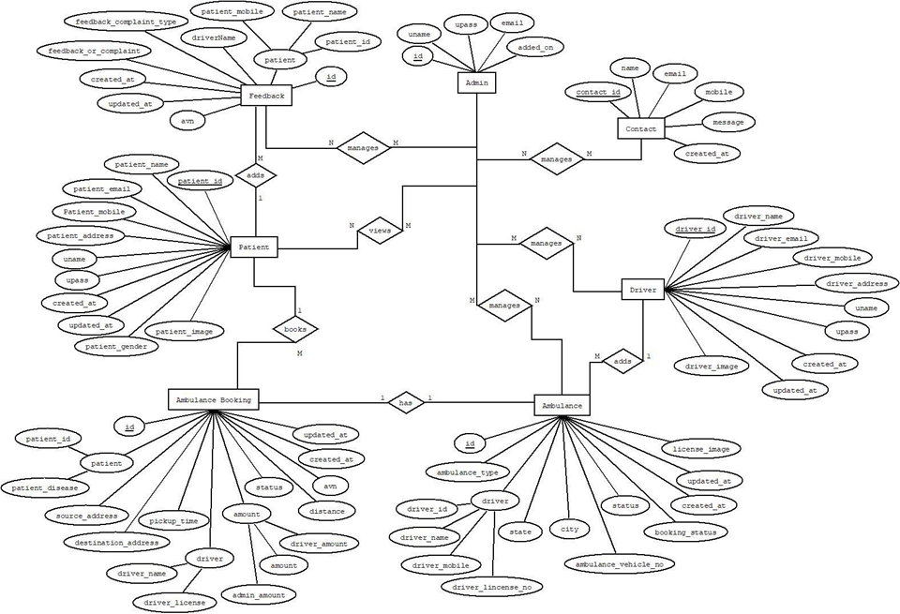


ER
DIAGRAM

Slide 7
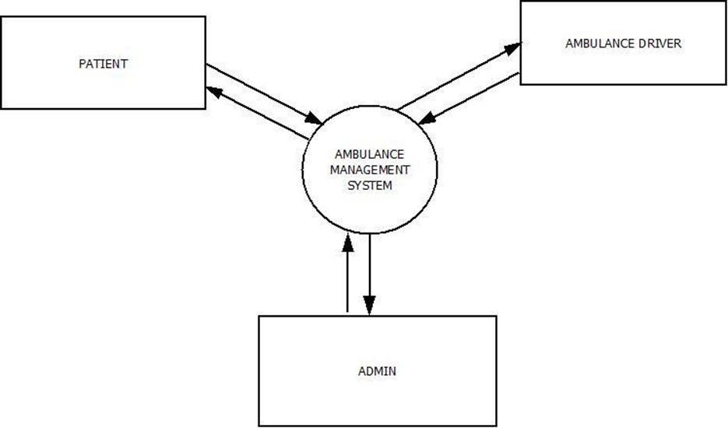

DATA FLOW DIAGRAM
LEVEL 0 DFD

Slide 8
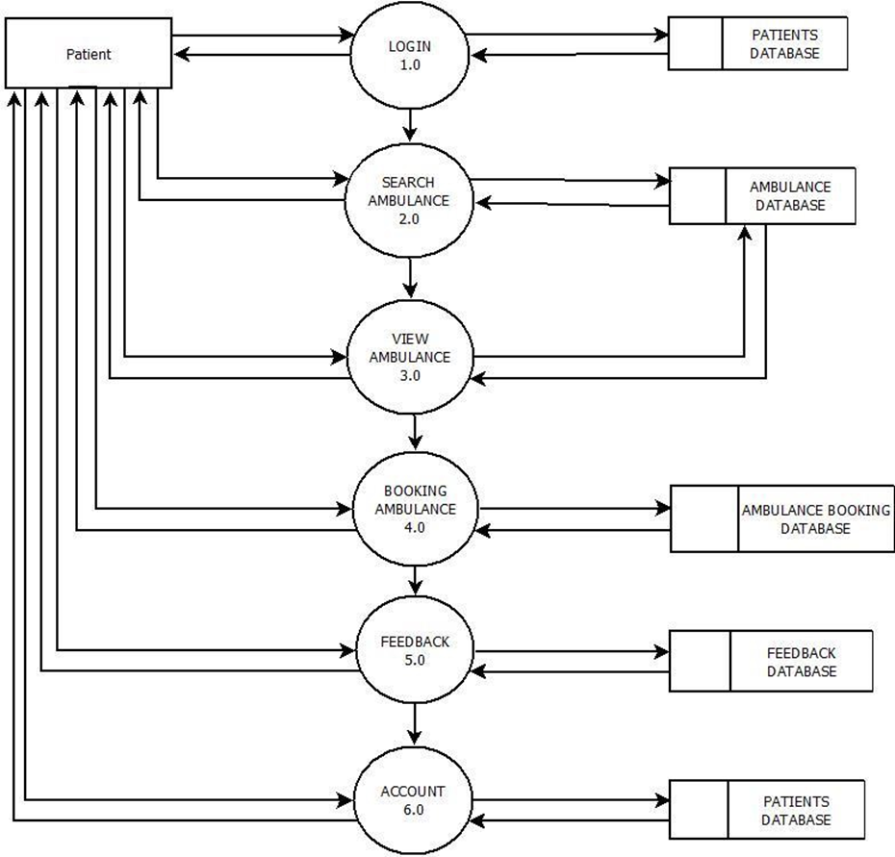
1ST LEVEL PATIENT
DFD

Slide 9
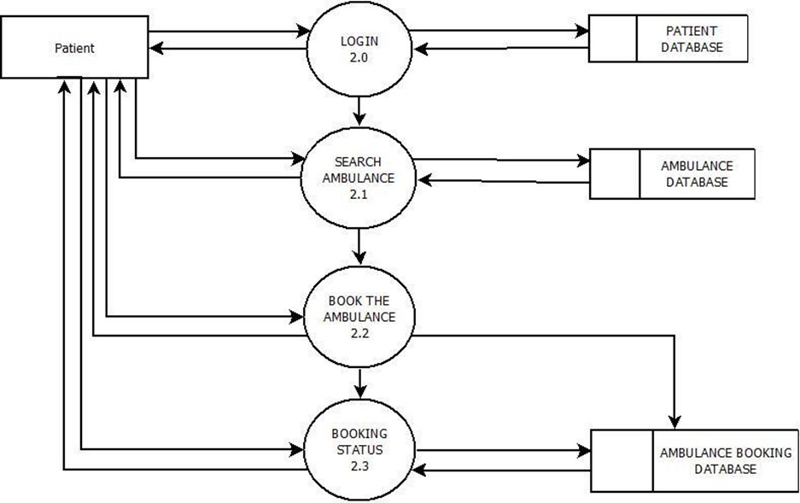
2ND LEVEL
PATIENT
DFD (2.0)

Slide 10
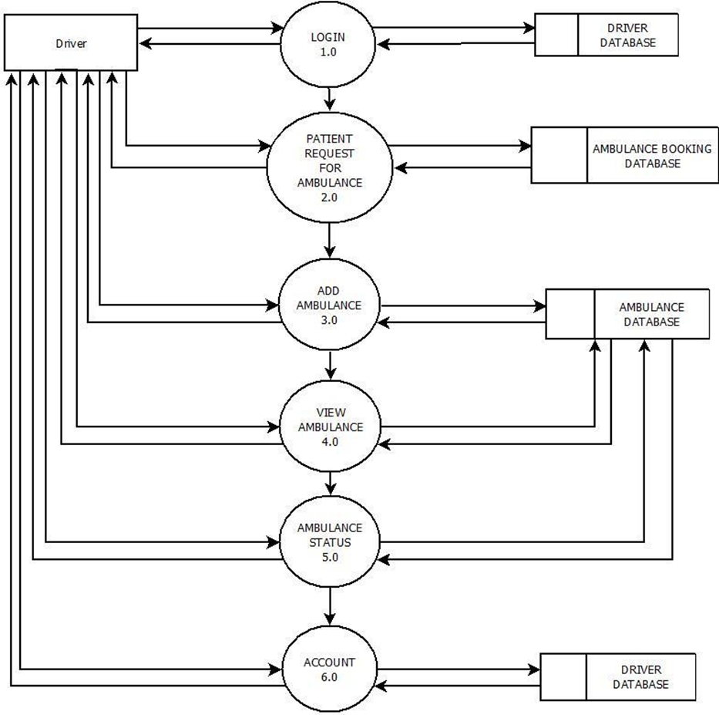
1ST LEVEL DRIVER
DFD

Slide 11
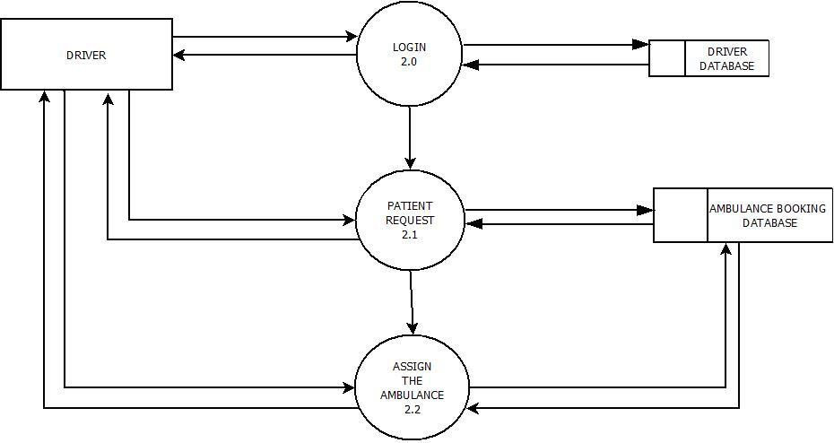
2ND LEVEL
DRIVER
DFD(2.0)

Slide 12
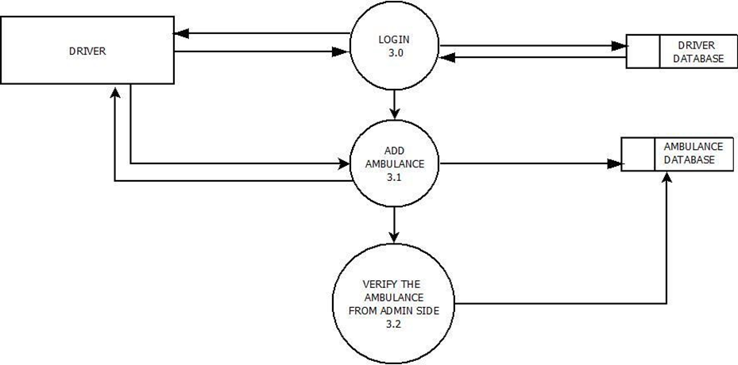
2ND LEVEL
DRIVER
DFD (3.0)

Slide 13
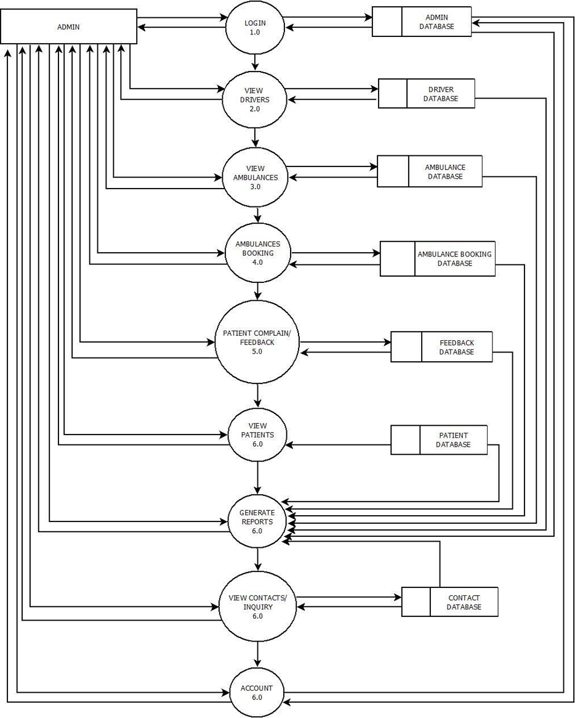
1ST LEVEL
ADMIN
DFD

Slide 14
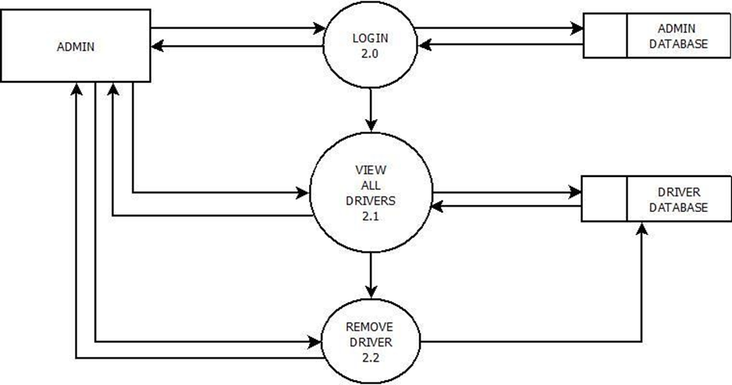
2ND LEVEL
ADMIN
DFD (2.0)

Slide 15
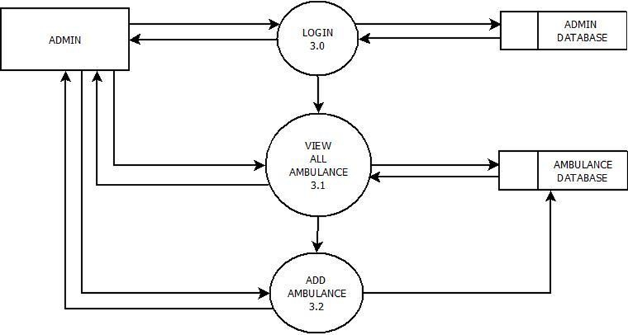
2ND LEVEL
ADMIN
DFD (3.0)

Slide 16
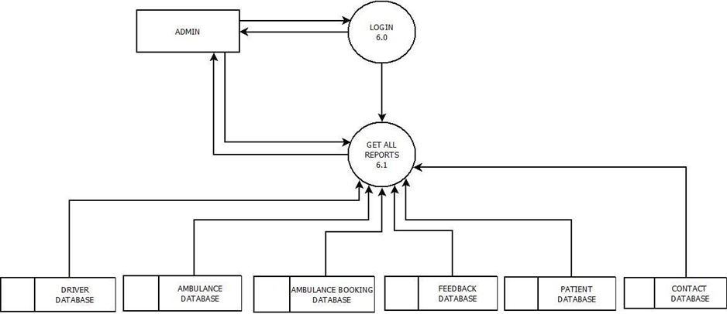
2ND LEVEL
ADMIN
DFD (6.0)

Slide 17


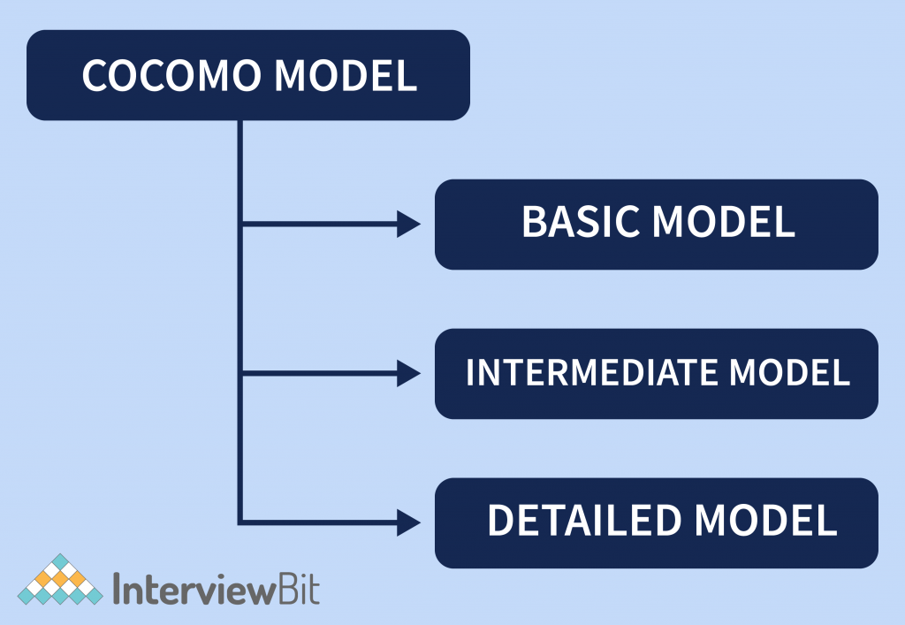

COCOMO MODEL
What is a COCOMO Model?
The COCOMO (Constructive Cost Model) is a widely used software cost estimation model that predicts the effort, total project cost, and scheduled time for a software development project. It relies on the number of lines of code in the software product. There are two types of COCOMO models: Basic COCOMO and Intermediate COCOMO

Slide 18

I) BASIC COCOMO :-
Effort = a(KLOC)^b PM [KLOC = Kilo Line of Code, PM = Person-Month]
Development Time = C(Effort)^d months
∴ LOC = 3KLOC
Oraganic :
∴ Effort = 2.4*(3)^1.05 Person-Month
= 2.4*3.16
= 7.584
≈ 8 Person-Month
∴ Development Time = 2.5*(7.584) ^0.38 months
= 2.5*2.15
= 5.37
≈ 5 Months
II) INTERMEDIATE COCOMO :-
Mode | ai | bi | ci | di
organic | 3.2 | 1.05 | 2..5 | 0.38
semi-deatched | 3.0 | 1.12 | 2.5 | 0.35
embedded | 2.8 | 1.20 | 2.5 | 0.32
Mode | A | B | C | D
Organic | 2.4 | 1.05 | 2.5 | 0.38
Semi-Detached | 3.0 | 1.12 | 2.5 | 0.35
Embedded | 3.6 | 1.20 | 2.5 | 0.32
EFFORT ADJUST FACTOR(EAF) :-
OUR PARAMETER - NORMAL CAPABLE PERSON & NORMAL EXPERIENCE
∴ EAF = 1.0*1.0= 1
∴ LOC = 3KLOC
1. ORGANIC :
∴ EFFORT = 3.2*(3) ^1.05 *1 PERSON-MONTH
= 3.2*3.16= 10.112≈ 10 PERSON-MONTH
∴ DEVELOPMENT TIME = 2.5*(10.112) ^0.38 MONTHS
= 2.5*2.40= 6≈ 6 MONTHS

Slide 19
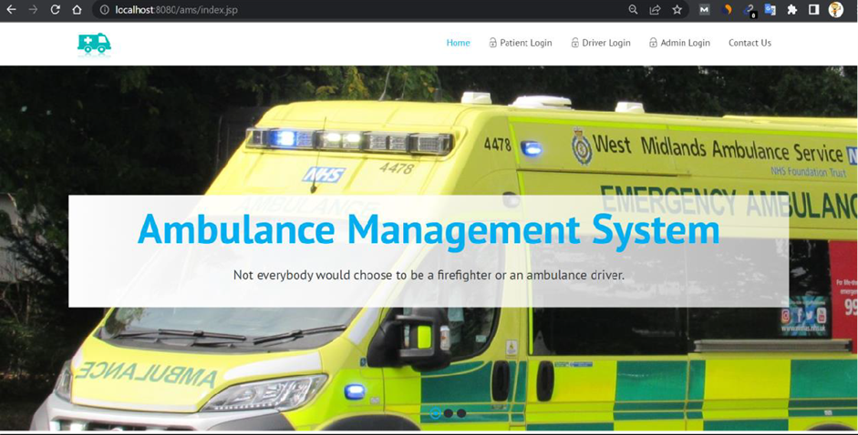
WEBPAGES
1. HOME PAGE:

Slide 20
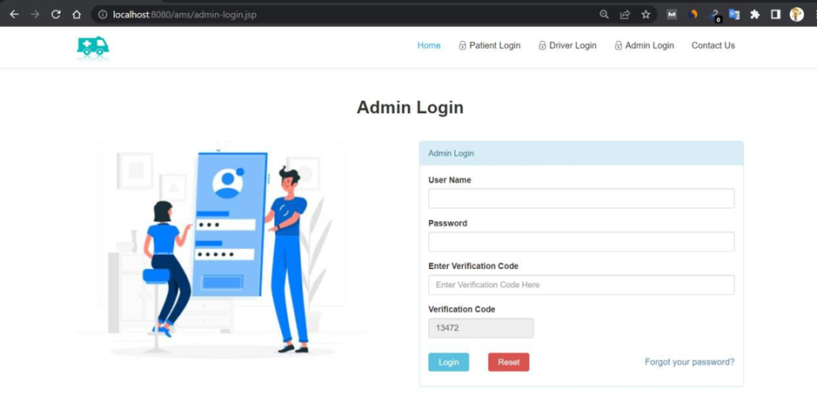
2. ADMIN LOGIN PAGE:

Slide 21
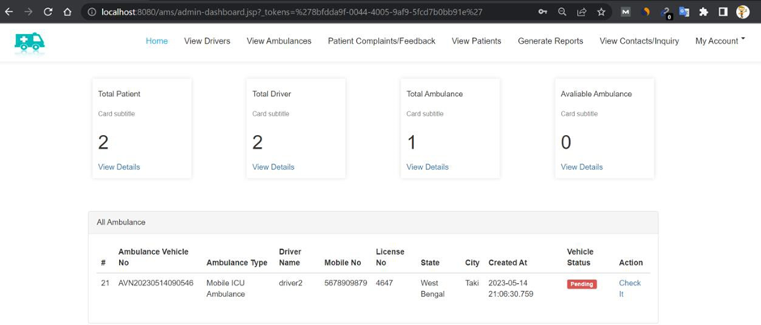
3. ADMIN DASHBOARD PAGE:

Slide 22
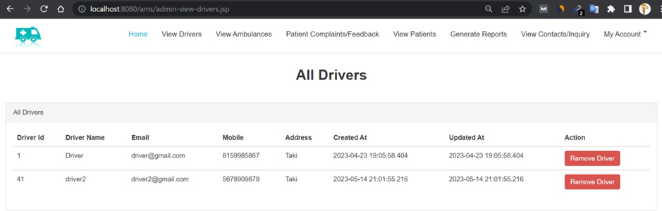
4. ADMIN VIEW DRIVER PAGE:

Slide 23
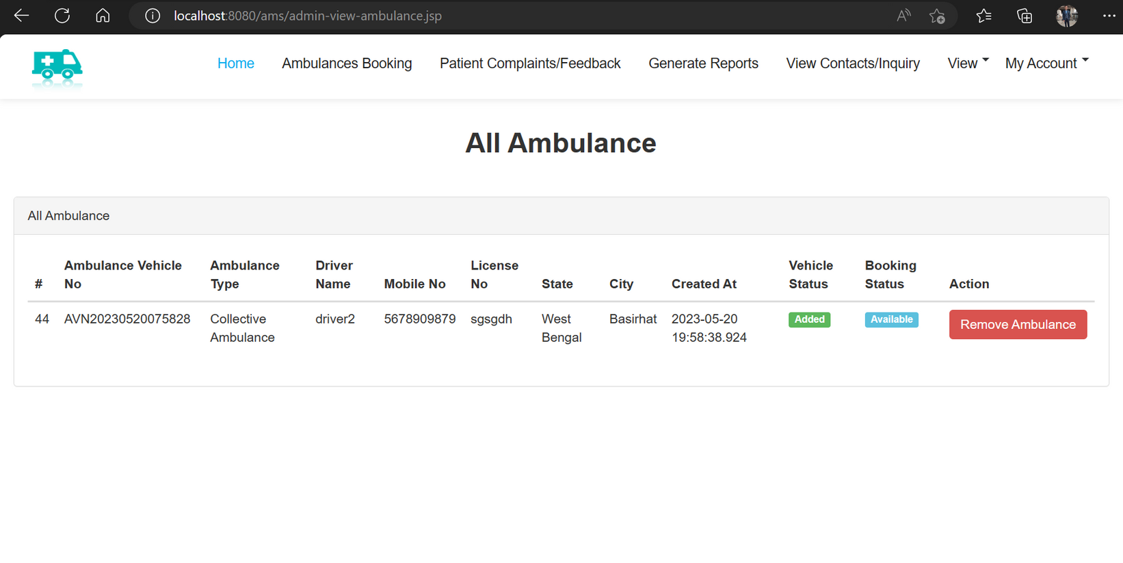
5. ADMIN VIEW AMBULANCE:

Slide 24
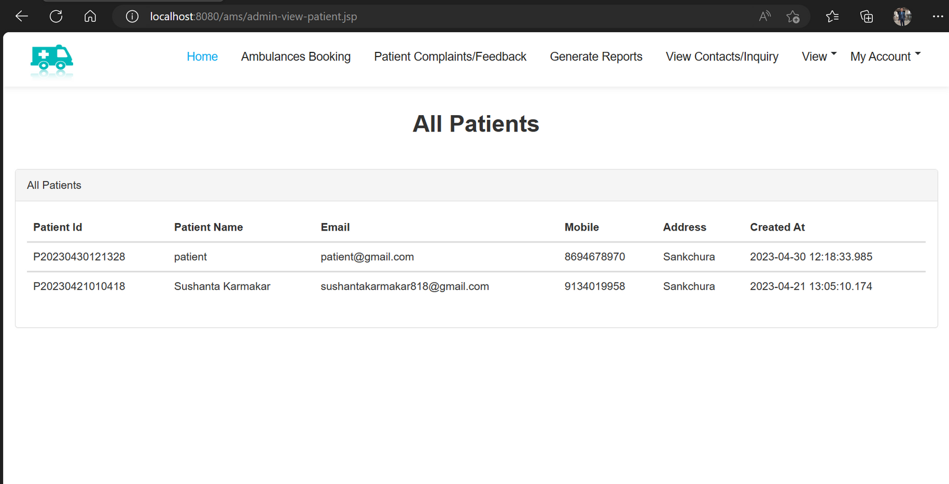
6. ADMIN VIEW PATIENTS:

Slide 25
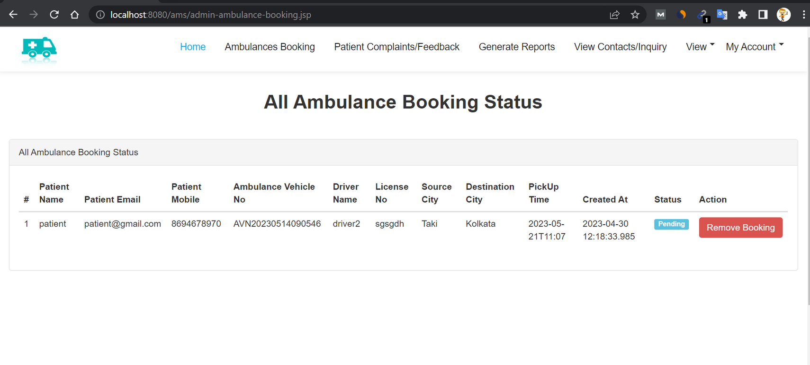
7. ADMIN VIEW ALL AMBULANCE BOOKING STATUS:

Slide 26
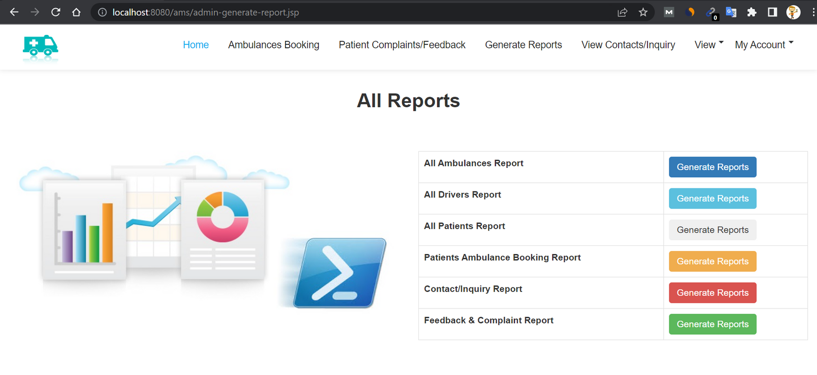
8. ADMIN GENERATE REPORTS:

Slide 27
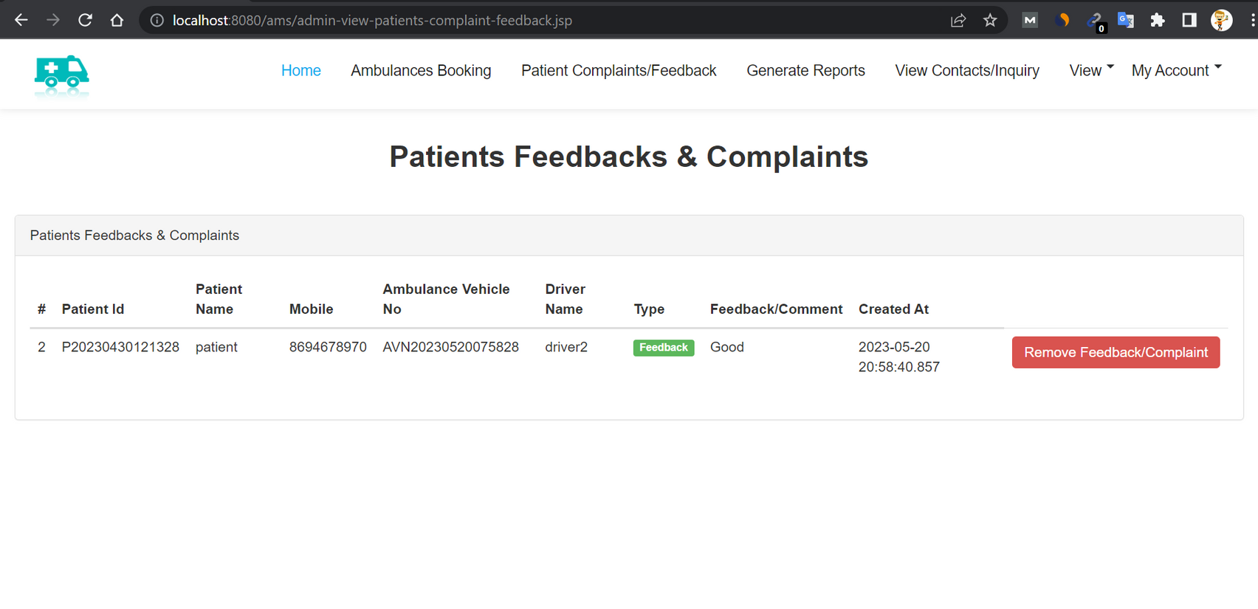
9. ADMIN PATIENT FEEDBACK:

Slide 28
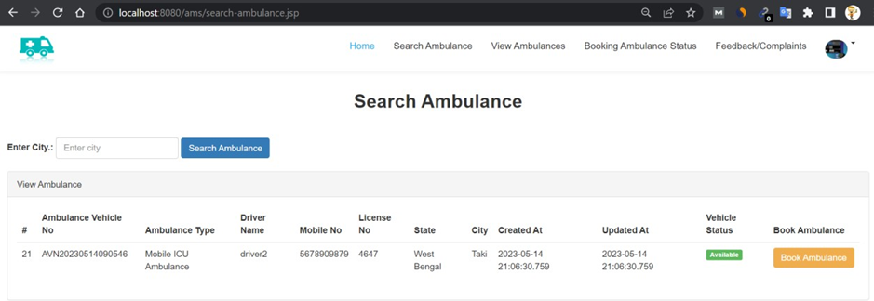
10. PATIENT SEARCH AMBULANCE PAGE:

Slide 29
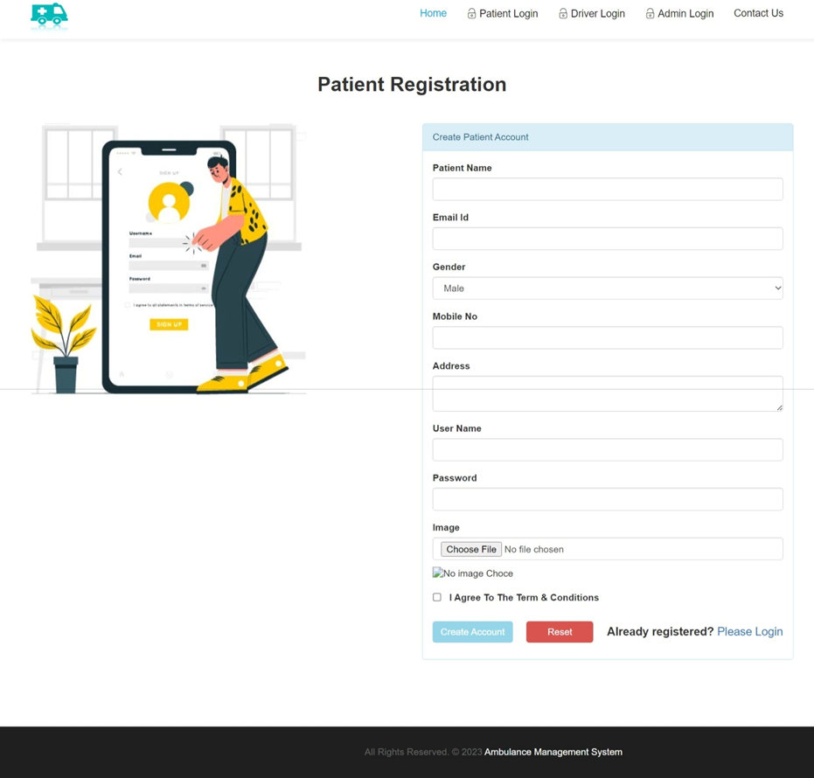
11. PATIENT REGISTER PAGE:

Slide 30
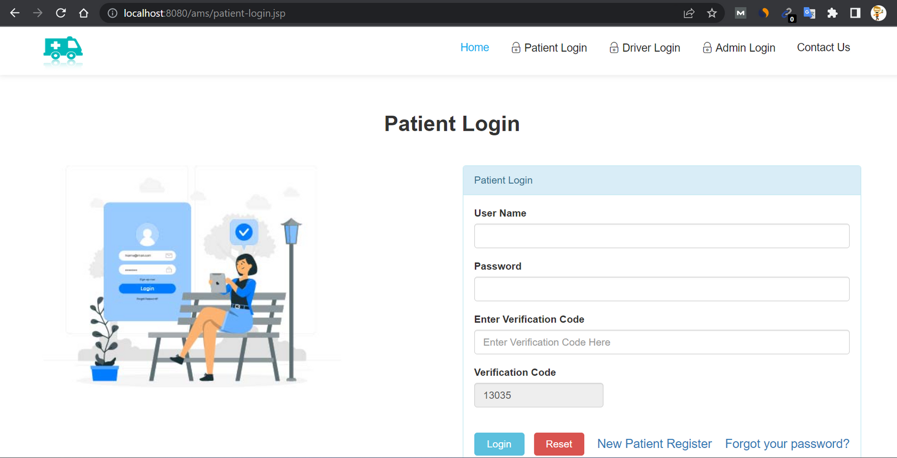
12. PATIENT LOGIN PAGE:

Slide 31
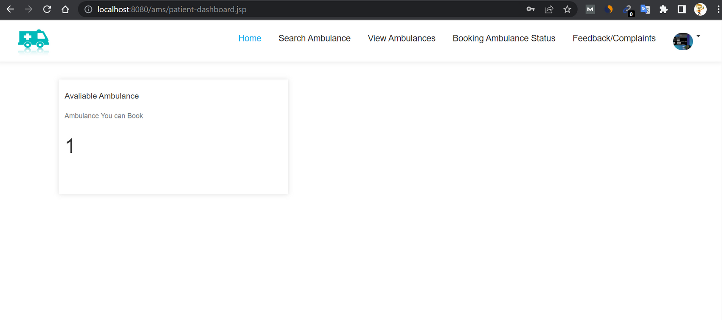
13. PATIENT DASHBOARD:

Slide 32
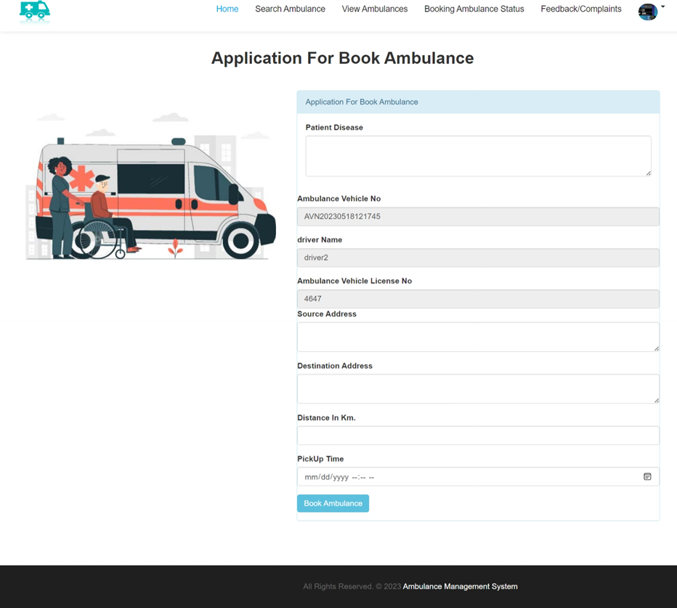
14. PATIENT BOOK AMBULANCE PAGE:

Slide 33
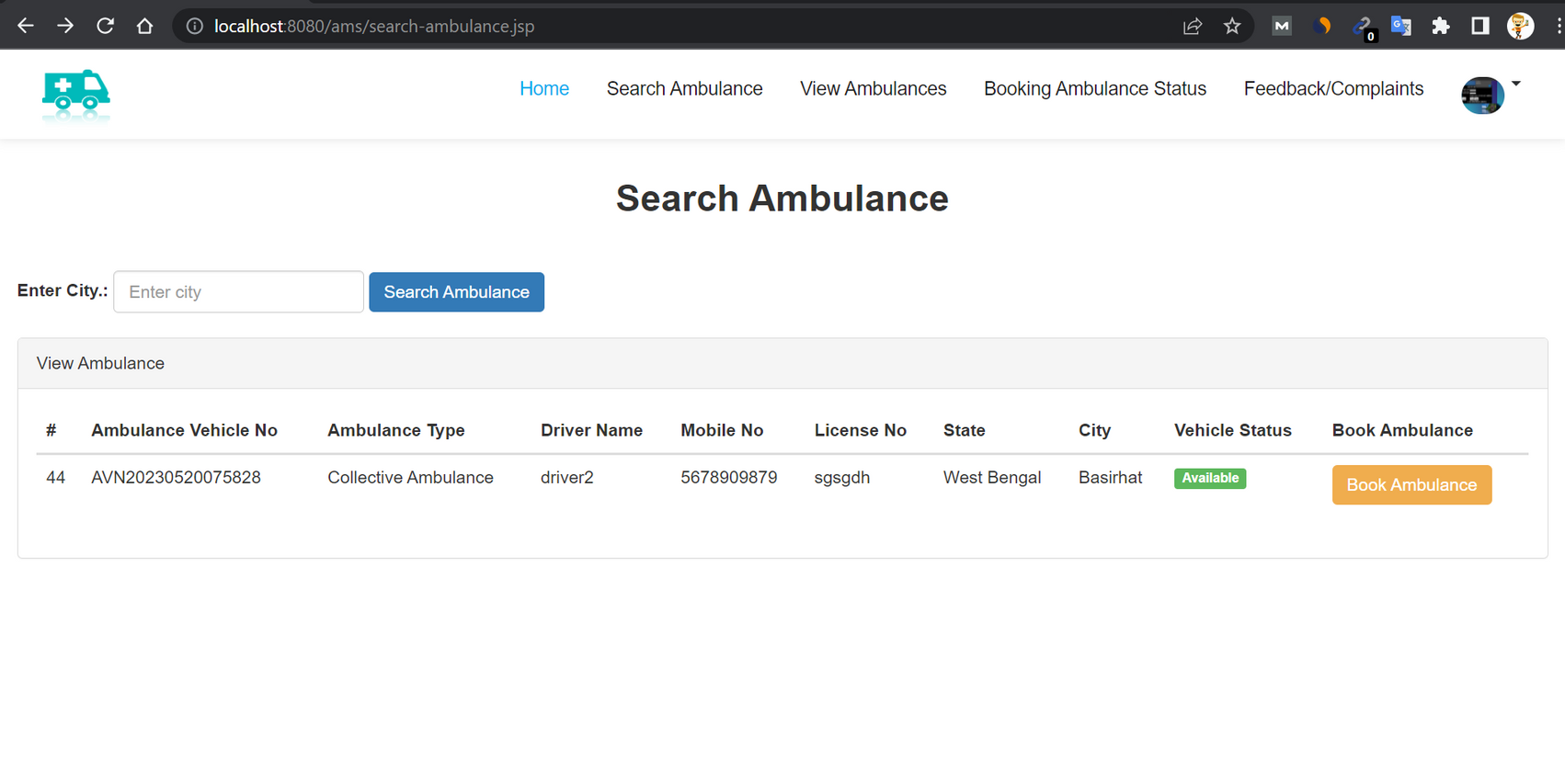
15. PATIENT SEARCH AMBULANCE PAGE:

Slide 34
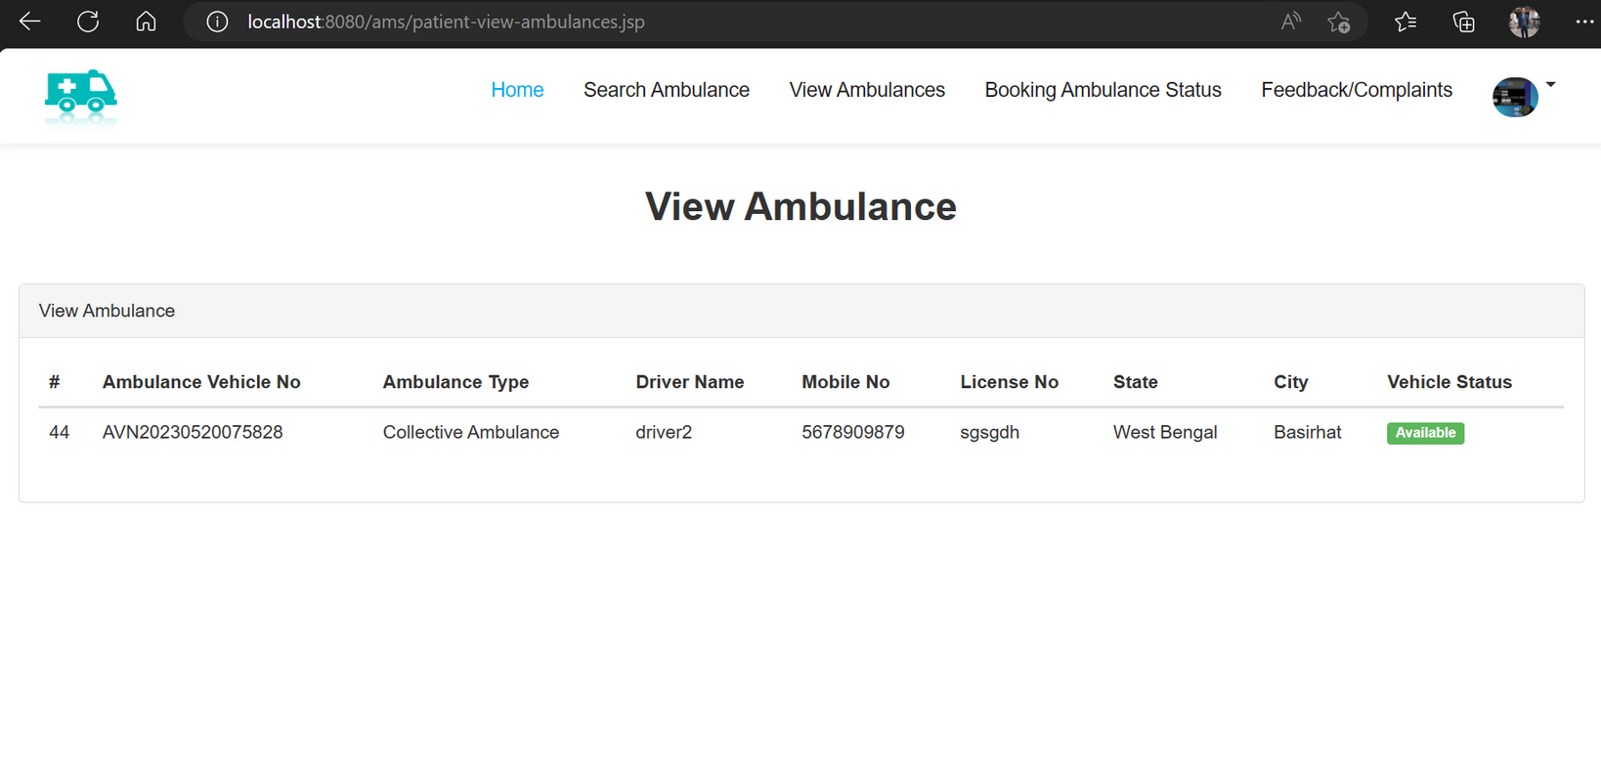
16. PATIENT VIEW BOOKING STATUS:

Slide 35
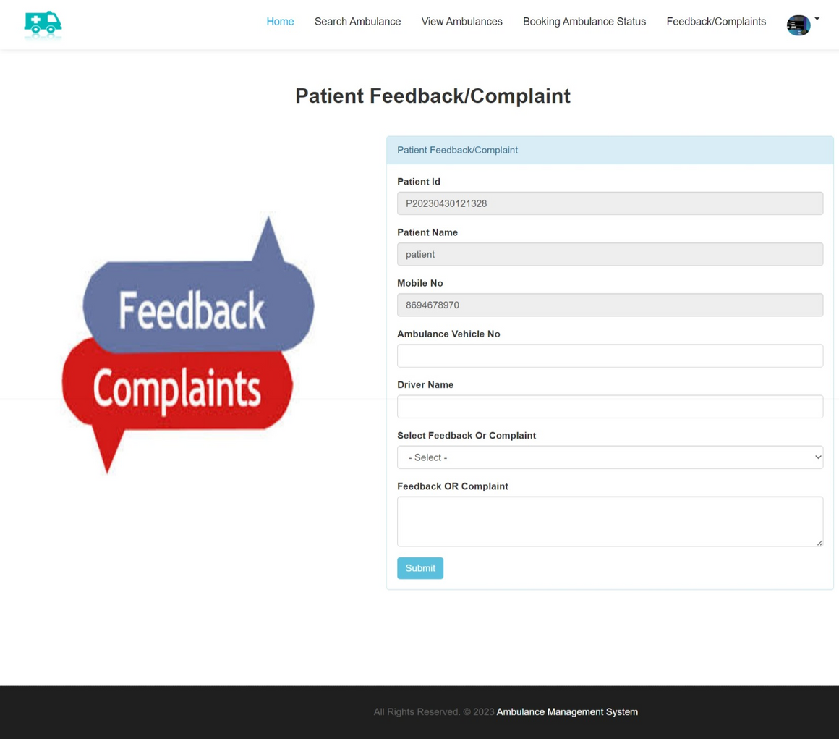
17. PATIENT FEEDBACKS PAGE:

Slide 36
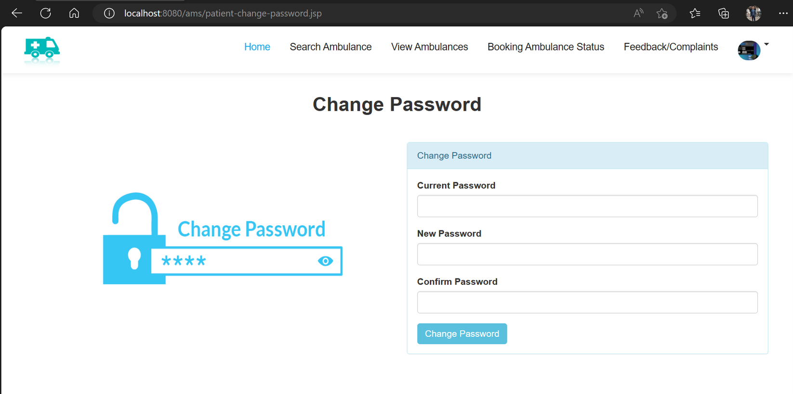
18. PATIENT CHANGE PASSWORD PAGE:

Slide 37
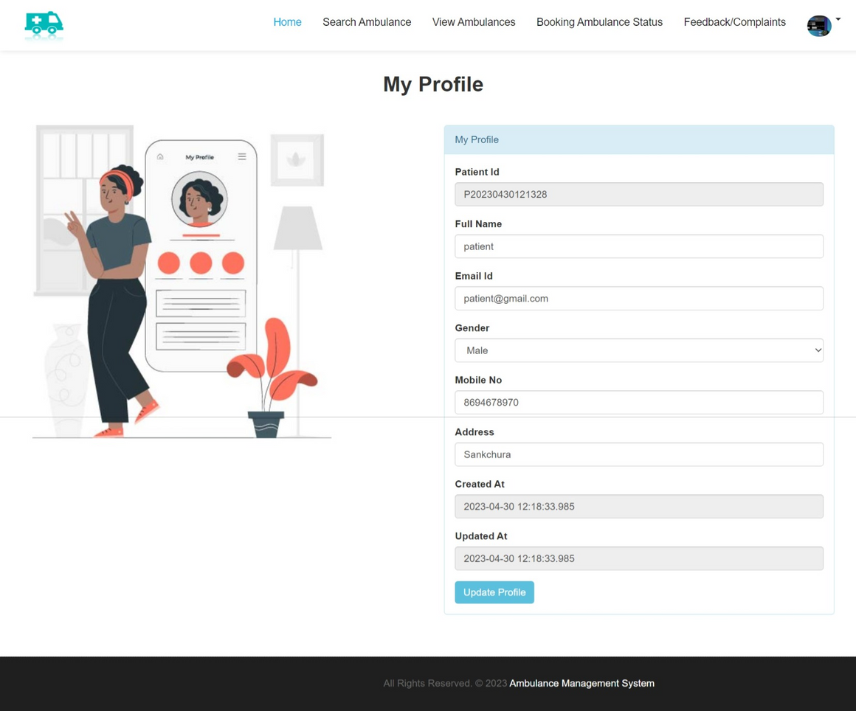
19. PATIENT UPDATE PROFILE PAGE:

Slide 38
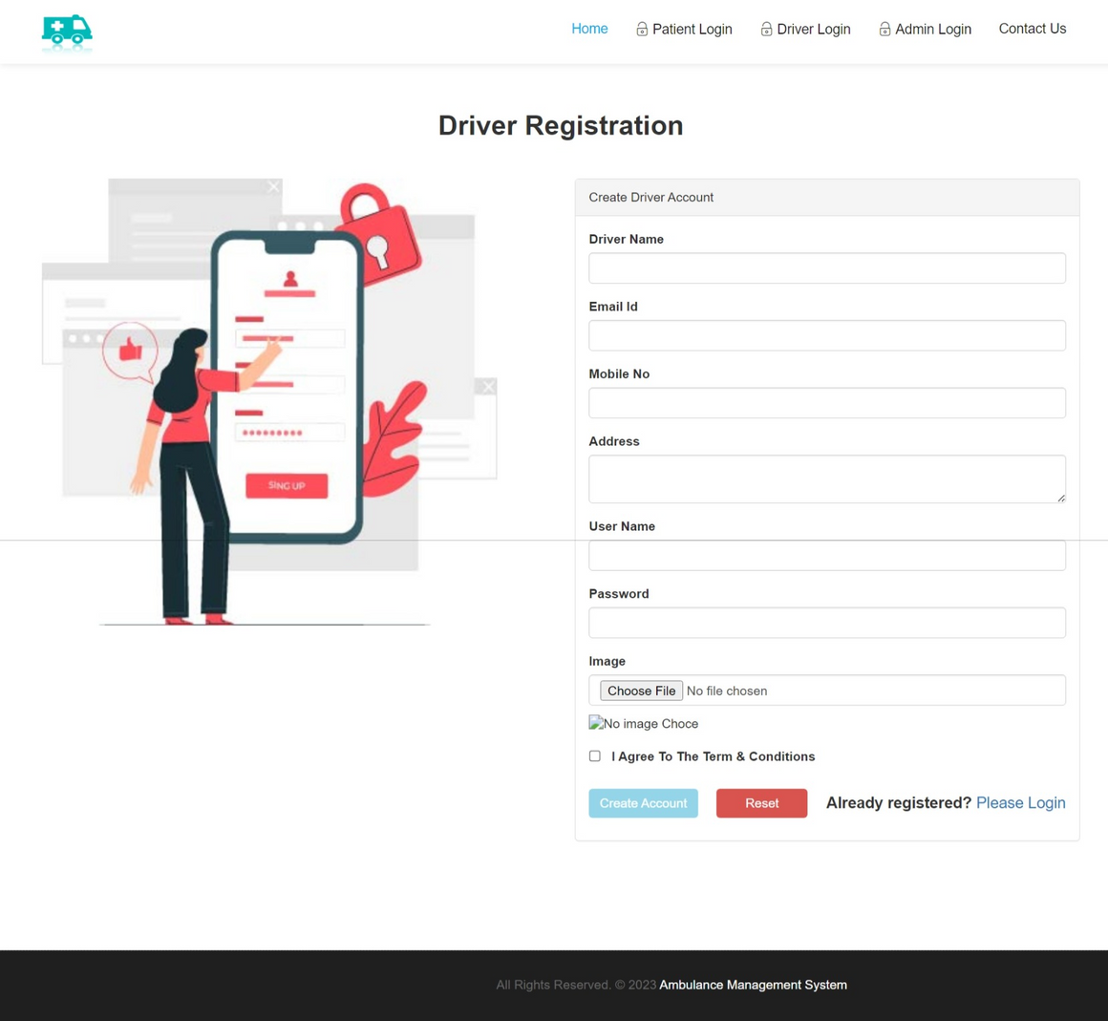
20. DRIVER REGISTRATION PAGE:

Slide 39
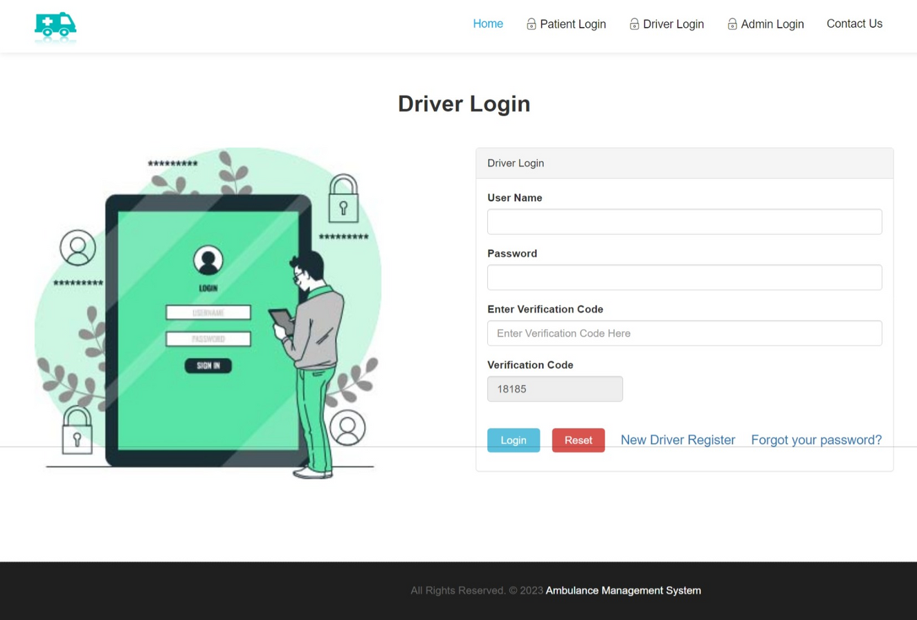
21. DRIVER LOGIN PAGE:

Slide 40
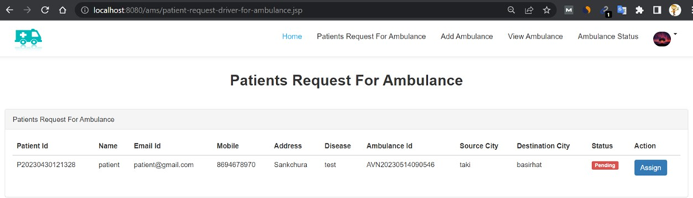
22. DRIVER AMBULANCE BOOKING PAGE:

Slide 41
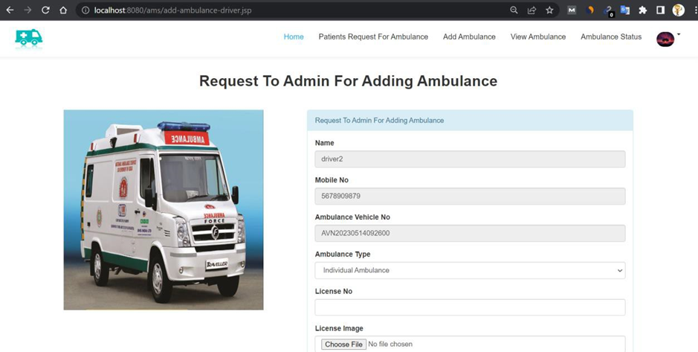
23. DRIVER ADD AMBULANCE PAGE:

Slide 42
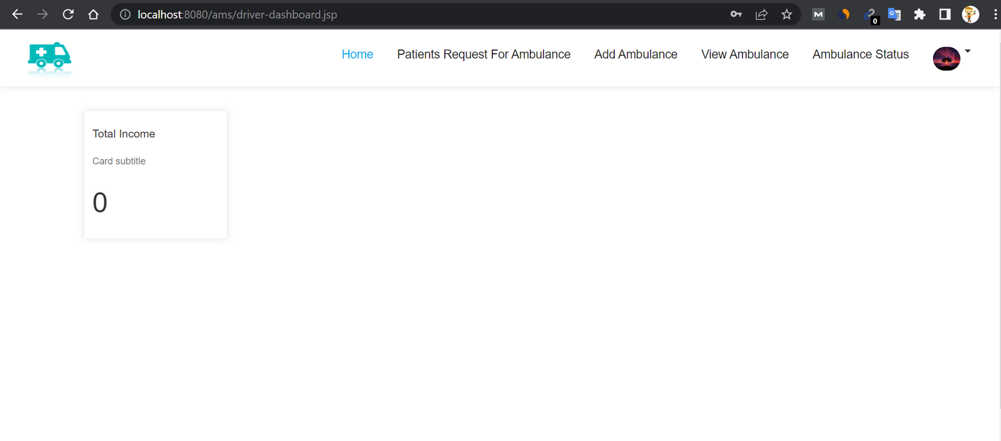
24. DRIVER DASHBOARD PAGE:

Slide 43
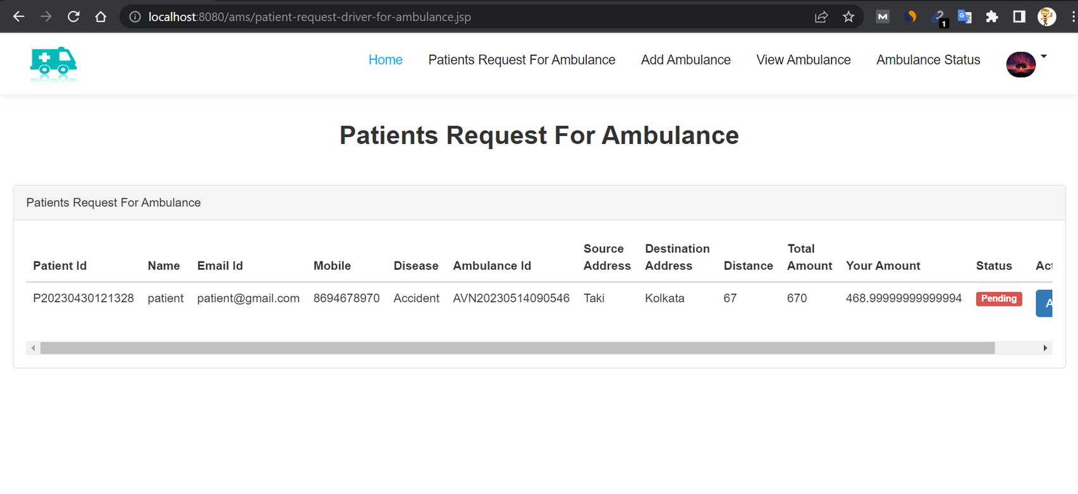
25. DRIVER AMBULANCE REQUEST FROM PATIENT PAGE:

Slide 44
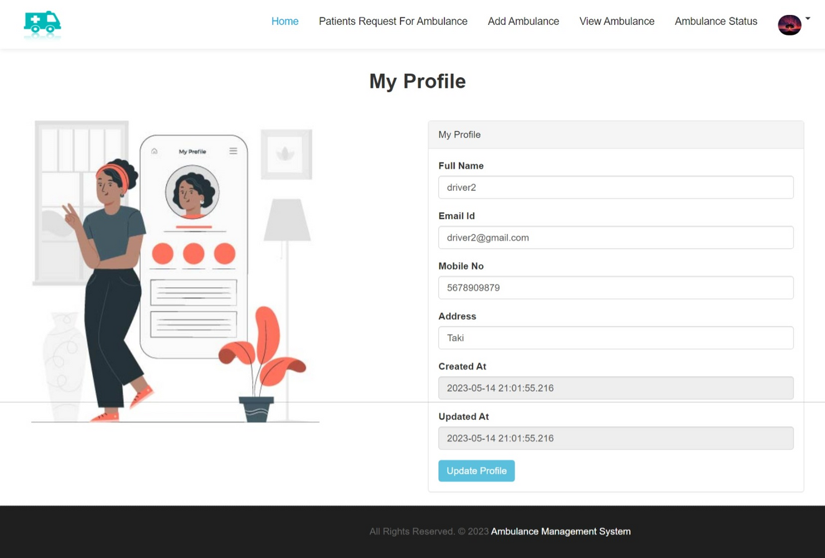
26. DRIVER PROFILE PAGE:

Slide 45
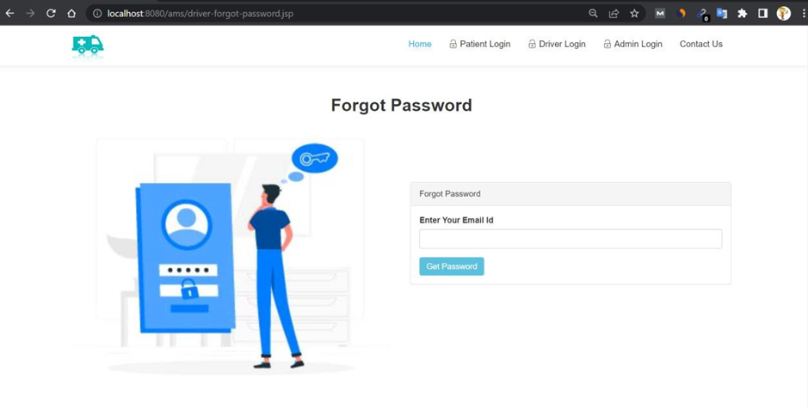
27. DRIVER FORGOT PASSOWRD PAGE:

Slide 46

FUTURE SCOPE
THE CURRENT VERSION OF THE SOFTWARE HAS SUCCESSFULLY MET THE SYSTEM OBJECTIVES. A COMPARISON WAS MADE BETWEEN THE BUILT SYSTEM AND THE ORIGINAL REQUIREMENTS, ENSURING ALIGNMENT. FUTURE WORK INCLUDES EXTENDING THE SYSTEM TO SEND PATIENT VITALS TO THE HOSPITAL ONCE THE PATIENT IS PICKED UP BY THE AMBULANCE. THIS CAN BE ACHIEVED BY UTILIZING DIFFERENT SENSORS TO MONITOR PATIENT HEALTH AND TRANSMITTING THE COLLECTED DATA TO THE HOSPITAL. THIS ENABLES PROMPT MEDICAL ASSISTANCE.
ADDITIONAL SENSORS SUCH AS BLOOD SUGAR MONITORING, ECG MONITORING, AND BLOOD GROUP DETECTION CAN BE IMPLEMENTED. THE SYSTEM CAN ALSO BE EXPANDED TO INCLUDE MORE AMBULANCE SERVICES. IN HOSPITALS, THE SYSTEM CAN BE IMPLEMENTED USING CAPACITIVE TOUCH SCREENS TO MAINTAIN PATIENT DATA.
FURTHERMORE, POTENTIAL ENHANCEMENTS INCLUDE INCORPORATING PAYMENT FACILITIES IN THE APPLICATION AND UTILIZING VOICE ALERTS FOR DEVICE CONTROL AND STATUS MONITORING

Slide 47


CONCLUSION
The application's main goal is to assist computer science students in comprehending the fundamentals of HTML, CSS, JavaScript, JSP, Servlet, and SQL. By navigating through the application and examining the code provided for each graphical representation, students should be able to grasp the implementation easily. Throughout the completion of this system, we have accomplished the following outcomes: successfully connecting Oracle database with Java servlet and learning how to query a database using Java

Slide 48

THANK YOU

